Slide 1
Discrete Structures

Slide 2
Discrete Mathematics and Its Applications Kenneth H. Rosen SEVENTH EDITION

Slide 3
Introduction to Logic
1.1 Propositional Logic
Propositions
A proposition is a declarative sentence (that is, a sentence that declares a fact) that is either true or false, but not both.
EXAMPLE l All the following declarative sentences are propositions.
1 . Washington, D.C., is the capital of the United States of America.
2 . Toronto is the capital of Canada.
3. 1 + 1 =2
4. 2 + 2 = 3

Slide 4
Some sentences that are not propositions are given in Example 2 .
EXAMPLE 2 Consider the following sentences.
1 . What time is it?
2 . Read this carefully.
3 . x + 1 = 2 .
4 . x + y = Z.
The truth value of a proposition is true, denoted by T, if it is a true proposition and false, denoted by F, if it is a false proposition.

Slide 5
We use letters to denote propositional variables (or statement variables), that is, variables that represent propositions, just as letters are used to denote numerical variables.
The area of logic that deals with propositions is called the propositional calculus or propositional logic.
compound propositions, are formed from existing propositions using logical operators.

Slide 6
DEFINITION 1 : Let p be a proposition. The negation of p, denoted by ¬p (also denoted by p), is the statement
"It is not the case that p."
The proposition ¬ p is read "not p." The truth value of the negation of p, - p, is the opposite of the truth value of p.

Slide 7
EXAMPLE 3 : Find the negation of the proposition
"Today is Friday.“ and express this in simple English.
Solution:
EXAMPLE 4: Find the negation of the proposition
2+2=5.
Solution:

Slide 8
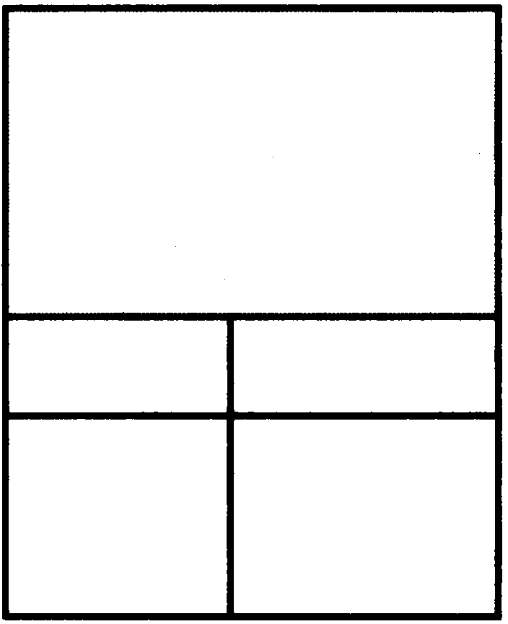
Table 1 displays the truth table for the negation of a proposition p.
The Truth Table for the Negation of a Proposition.
This table has a row for each of the two possible truth values of a proposition P. Each row shows the truth value of ¬P corresponding to the truth value of p for this row.
p ¬ p
T F
F T

Slide 9
The negation operator constructs a new proposition from a single existing proposition. We will now introduce the logical operators that are used to form new propositions from two or more existing propositions. These logical operators are also called connectives.

Slide 10
DEFINITION 2
Let p and q be propositions. The conjunction of p and q, denoted by p /\ q, is the proposition "p and q ." The conjunction p /\ q is true when both p and q are true and is false otherwise.

Slide 11
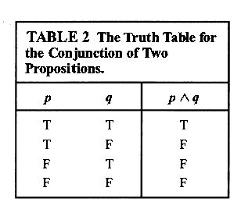

Slide 12
EXAMPLE 5 Find the conjunction of the propositions p and q where p is the proposition "Today is Friday"
and q is the proposition "It is raining today.“
Solution:

Slide 13
DEFINITION 3:
Let p and q be propositions. The disjunction of p and q, denoted by p V q, is the proposition
"p or q ." The disjunction p V q is false when both p and q are false and is true otherwise.

Slide 14
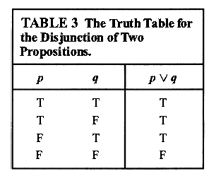

Slide 15
EXAMPLE 6:
What is the disjunction of the propositions p and q where p is the proposition "Today is Friday“ and q is the proposition "It is raining today.“
Solution:

Slide 16
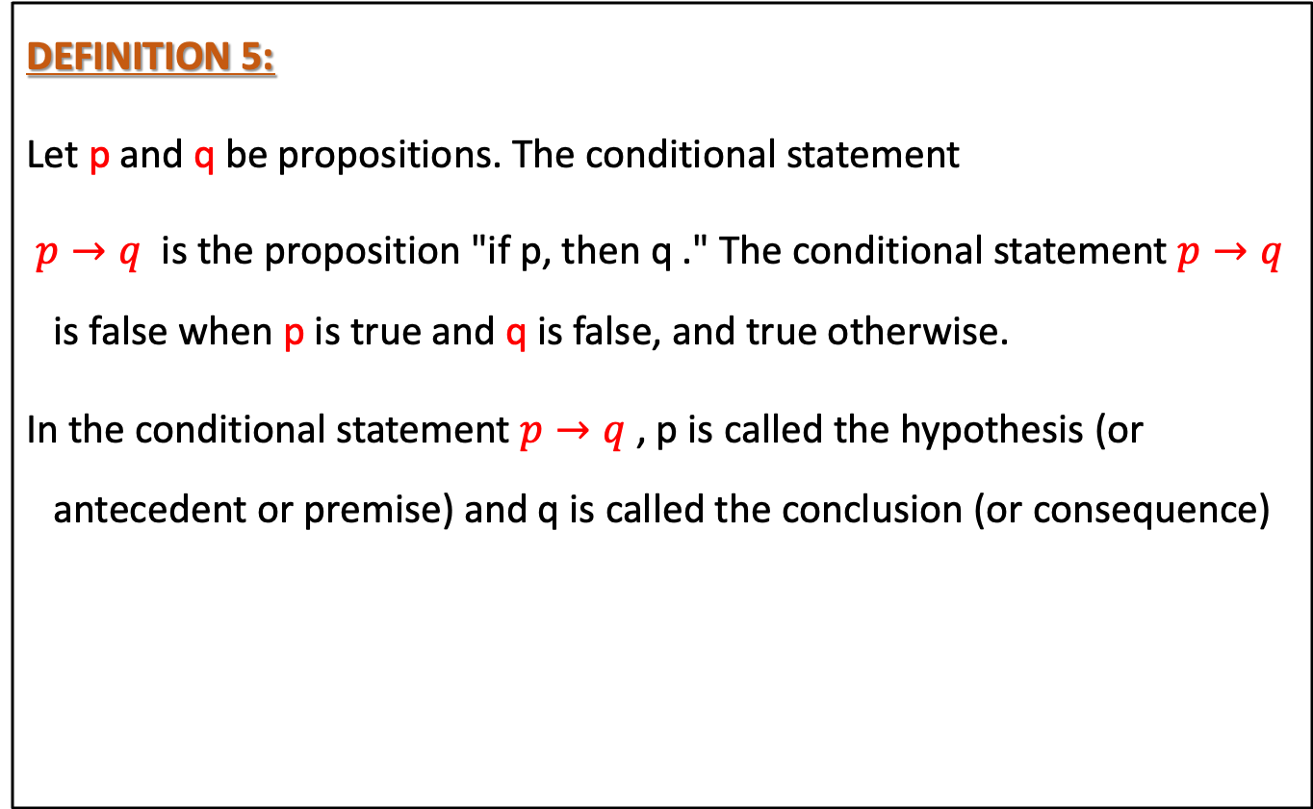
Conditional Statements
DEFINITION 5:
Let p and q be propositions. The conditional statement
$p→q$ is the proposition "if p, then q ." The conditional statement $p→q$ is false when p is true and q is false, and true otherwise.
In the conditional statement $p→q$ , p is called the hypothesis (or antecedent or premise) and q is called the conclusion (or consequence)

Slide 17
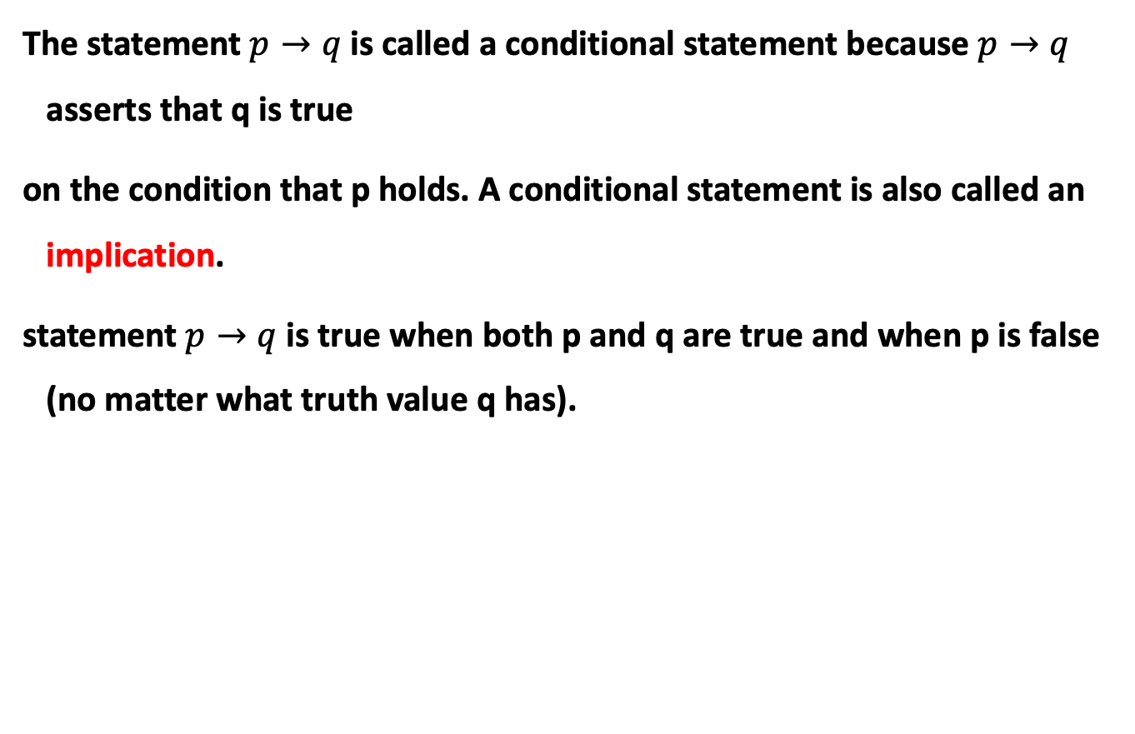
The statement $p→q$ is called a conditional statement because $p→q$ asserts that q is true
on the condition that p holds. A conditional statement is also called an implication.
statement $p→q$ is true when both p and q are true and when p is false (no matter what truth value q has).

Slide 18
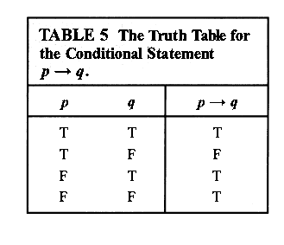

Slide 19
CONVERSE, CONTRAPOSITIVE, AND INVERSE
We can form some new conditional statements starting with a conditional statement p → q .
In particular, there are three related conditional statements that occur so often that they have special names.
1/ The proposition q → p is called the converse of p → q .
2/ The contrapositive of p → q is the proposition -q → -p.
3/ The proposition -p → -q is called the inverse of p → q.
We will see that of these three conditional statements formed from p → q , only the contrapositive always has the same truth
value as p → q .

Slide 20
When two compound propositions always have the same truth value we call them equivalent,
so that a conditional statement and its contrapositive are equivalent
The converse and the inverse of a conditional statement are also equivalent, but neither is equivalent to the original conditional statement

Slide 21
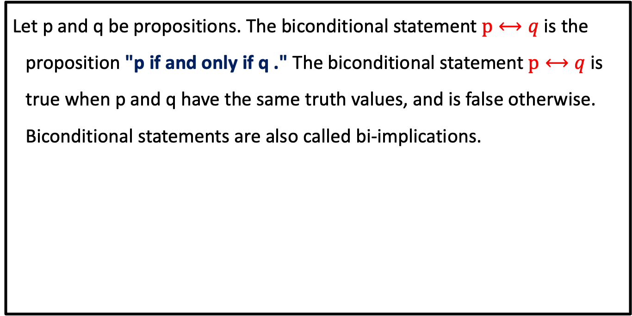
BICONDITIONALS
Let p and q be propositions. The biconditional statement $p⟷q$ is the proposition "p if and only if q ." The biconditional statement $p⟷q$is true when p and q have the same truth values, and is false otherwise. Biconditional statements are also called bi-implications.

Slide 22
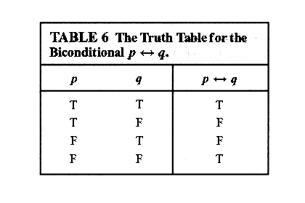

Slide 23
There are some other common ways to express p ↔ q:
"p is necessary and sufficient for q "
"if p then q , and conversely"
"p iff q ."

Slide 24

Truth Tables o f Compound Propositions

Slide 25
Homework
Page 12, 13,14,15
1 (a,c,e,f)
3 (a,c)
8 (a,b,c,f,g)
16(a,d)
17(a,b)
31 (d,e)
36 (b)
37 (a)
L

